Slide 1
Introduction to Commercial
Open Source Startups
Prof. Dr. Dirk Riehle
Friedrich-Alexander University Erlangen-Nürnberg
COSS A01
Licensed under CC BY 4.0 International
Notes:
It is Friedrich-Alexander University Erlangen-Nürnberg – FAU, in short.
Corporate identity wants us to say “Friedrich-Alexander University”.

Slide 2
Course Learning Goals
Understand ...
  The software industry and its players
  Commercial open source startups
Learn how to …
  Get an open source project off the ground
  Spin-off a startup from university
  Analyze and design a business model

Slide 3
Skills Required for Course
Required ...
  Basic business understanding
Familiar with ...
  N/A
Expected of student
  Self-study where necessary
  Team work for project

Slide 4
Course Content
The software industry
  The software industry
  Software vendors
  Open source software
Open source projects
  Open source projects
  Getting users and contributions
  Marketing and governance
Commercial open source
  Commercial open source
  Intellectual property
  Product management
University spin-offs
  The university spin-off
  Preparing and leaving
  Funding and growth

Slide 5
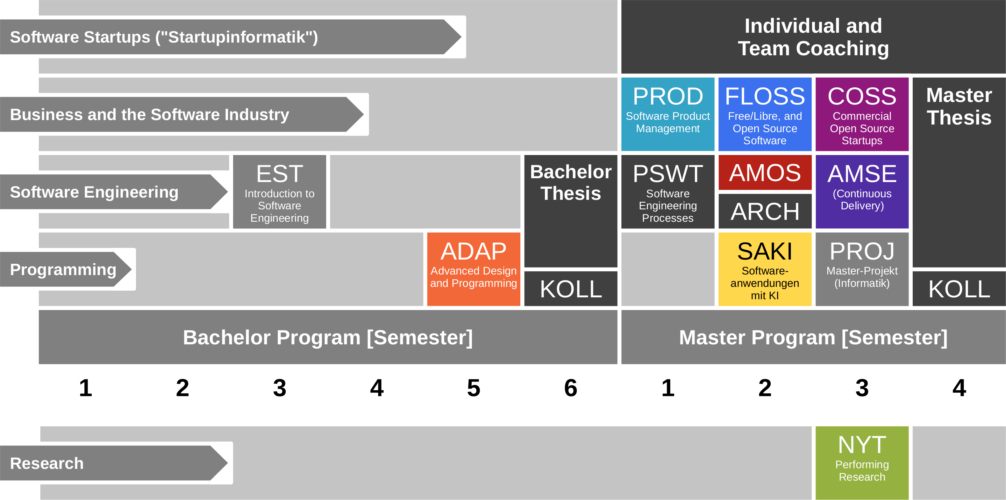
Course Position in Curriculum

Slide 6
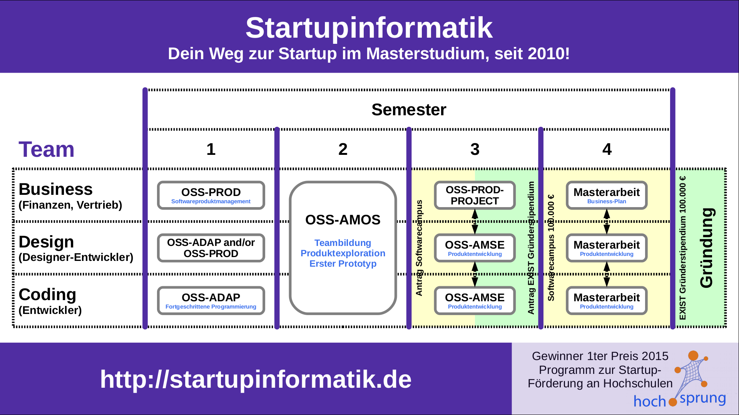
ADAP is Part of Startupinformatik

Slide 7
Courses and Modules
 |  | Courses (Lehrveranstaltungen)
 |  | OSS-COSS-VUE |  | Total ECTS
Modules | OSS-COSS | x |  | 5
VUE = Lecture + exercise (Vorlesung + Übung)
PROJ = Project

Slide 8
Course Grading [1]
Class quizzes = 10%, graded [0..10]
  Administered for each video lecture
Homework = 10%, graded using [0|1]
  Three homework submissions during course of semester
Participation = 10%, graded using [0|1|2|3]
  For nine exercises, present your homework in class
Final report = 20%, graded using [0..10]
  Three sections (out of nine) for each of the three roles
Oral exam = 50%, graded using regular grades
  If you and we agree, the oral exam can be dropped
[1] Also see http://osr.cs.fau.de/teaching/course-resources/grading-schemes-and-scales/

Slide 9
Course Work (Homework) [1]
Student teams design a business model as course work; consists of
  Three homework submissions during semester
  Graded explanation of homework in exercises
  Compilation and presentation in final report
Student teams consist of three people, each playing one role
  “Hustler” (sales and marketing)
  “Designer” (user experience)
  “Coder” (software engineering)
Student teams choose one of (most likely) three projects to work on
  Students pitch a project idea (optional)
  Students prioritize available projects
  We decide, if necessary, with backup
[1] Also see https://bit.ly/2Mu8IFy

Slide 10
2
3
Key
Activities
1
1
2
Customer Relationships
Key Partners
Customer
Segments
Value
Proposition
Key Re-sources
2
3
Channels
3
Cost Structure
1
Revenue Streams

Slide 11
Homework Schedule Overview
Homework bundle 1 (week 6)
  Customer segments
  Value proposition
  Revenue sources
Homework bundle 2 (week 9)
  Customer relationships
  Key partners
  Key resources
Homework bundle 3 (week 12)
  Channels
  Key activities
  Cost structure
Final report (week 15)

Slide 12
Receiving a Grade for the Course
If you want to receive a grade
  You must register through the course management system
If you cannot register through the course management system
  Please follow these instructions: https://wp.me/PDU66-2bx
Otherwise: No grade

Slide 13

No Oral or Written Exam [1]
[1] You still have to register for the course

Slide 14
Course Language [1]
Class
  Lecturer: English
  Student: Choice of German or English
Homework
  Instructor: English
  Submissions: Choice of German or English
[1] See http://osr.cs.fau.de/2012/03/10/english-or-german-deutsch-oder-englisch/

Slide 15

Course Communication
Announcements by email (through StudOn)
Questions and answers using FSI Forum for course
If you must send email, use the teaching team alias from course index

Slide 16
Course Information
Course overview
  https://oss.cs.fau.de/oss-coss-course

Slide 17
Thank you! Questions?
dirk.riehle@fau.de – http://osr.cs.fau.de
dirk@riehle.org – http://dirkriehle.com – @dirkriehle
DR

Slide 18
Credits and License
Original version
  © 2020 Dirk Riehle, some rights reserved
  Licensed under Creative Commons Attribution 4.0 International License
Contributions
  None yet

